Slide 1






SUPERSTORE SALES ANALYSIS
Presentation
Mohamed Nabih
Adnan Omar
Fares Hamada
Arwa Abaza
Fatma Tamer

Slide 2
INTRODUCTION
Analysis questions and recomendd solutions
Data Cleaning
Data Exploration

Slide 3
DATA CLEANING
First we started by understanding the data and knowing what each cloumn means, The we started cleaning the data.
First we checked on null values in all columns and we found only 11 null values so we removed them as they will not affect on the data, then we removed the dublicated rows and we splitted the order date column by months and years to get more useful insights.

Slide 4
DATA EXPLORATION
First we analysed the data by the selling products
Top 10 Most sold products
Top 10 highest revenue from the products.
Top selling products by category

Slide 5
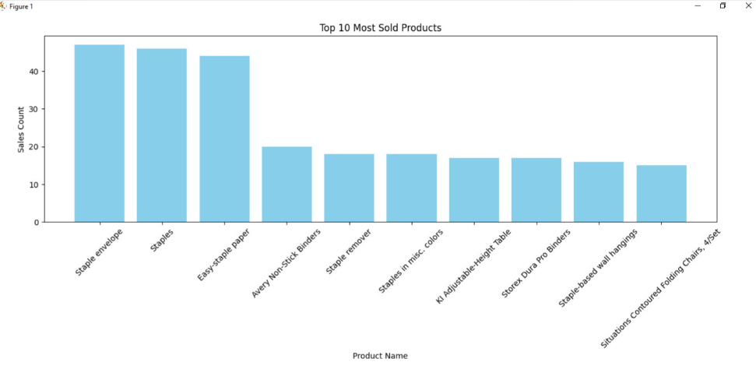

Slide 6
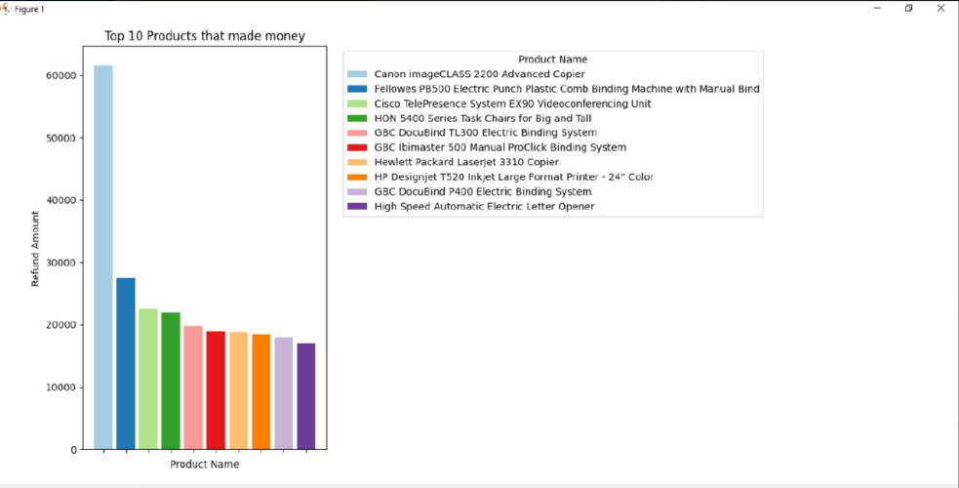

Slide 7
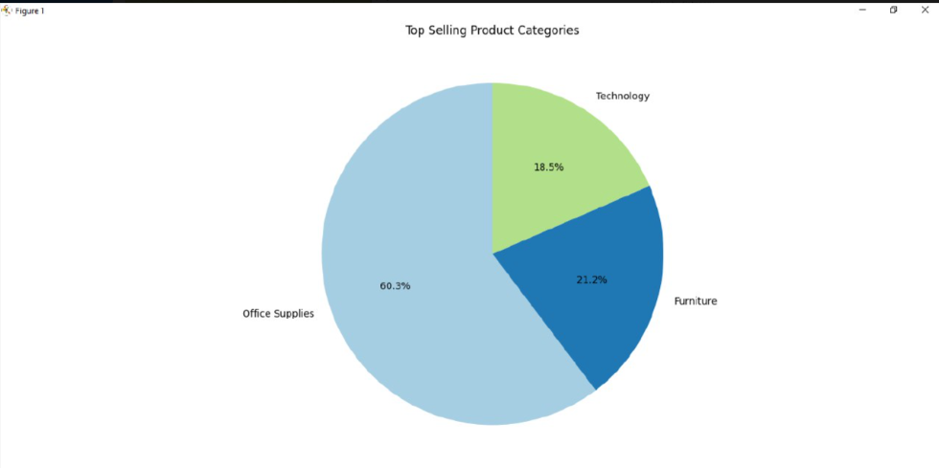

Slide 8
THEN SOME ANALYSIS FOR THE SHIPPING AND TIME PERFORMANCE
Most used shipping method
Average shipping time by year
Monthly sales trends over the year

Slide 9
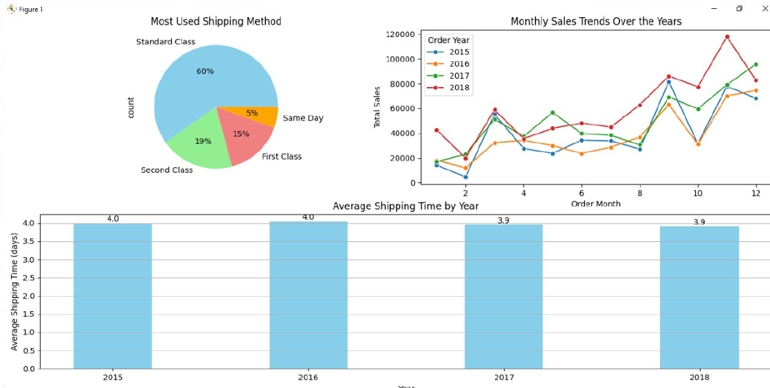
Simple chart for each the perevious data.

Slide 10
Some exploration for the data depending on the geography
Top region by the total sales
Top 10 cities by sales
Top 10 states by sales

Slide 11
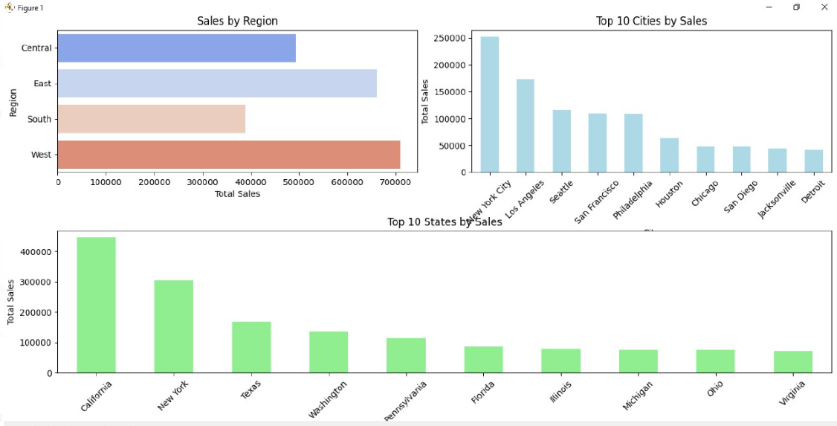

Slide 12
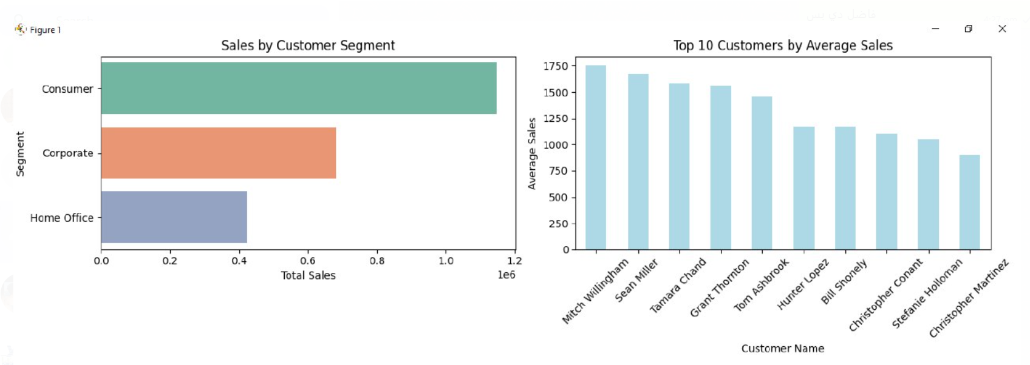
THE EXPLORATION FOR THE DATA BY THE CUSTOMERS AND ORDERS

Slide 13
DATA ANALYSIS
Why does the orders got dellayed during shipping?
We answered this question by calculating the average shipping time by shipping mode and we found out that standard shipping class takes the longest time of days, then we go deep to know if the region or the product category also depends on the delays or not? and here what we found.
We also analysied for the customers to see the top 10 customers by average sales
and the top 10 customers by purchase count.

Slide 14
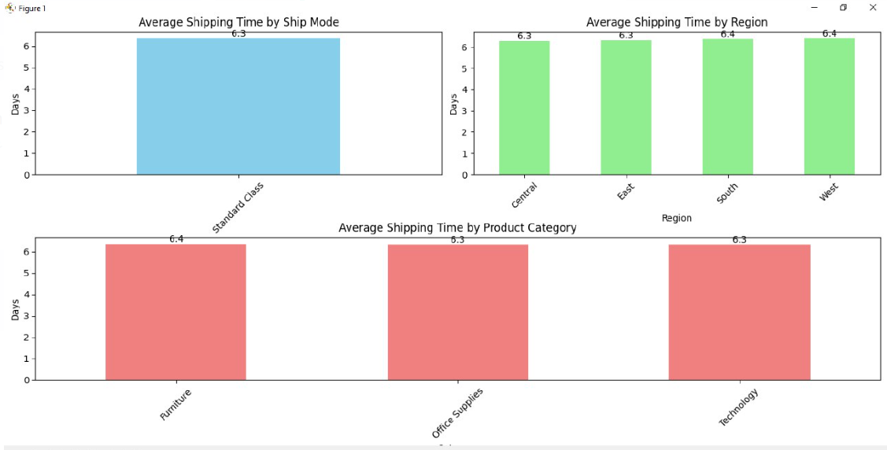
AS WE CAN SEE THAT AVERAGE SHIPPING TIME IN STANDARD CLASS TAKES MORE THAN 5 DAYS AND THE REGION OR CATEGORY DOES NOT DEPEND ON THE SHIPPING TIME

Slide 15
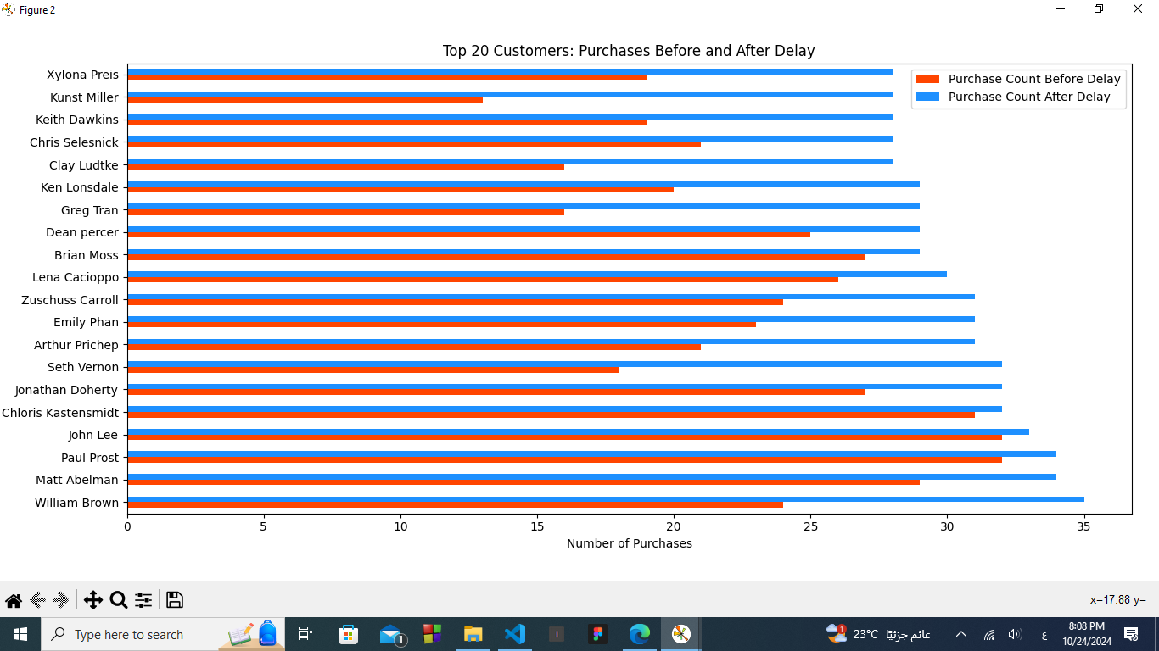

Slide 16
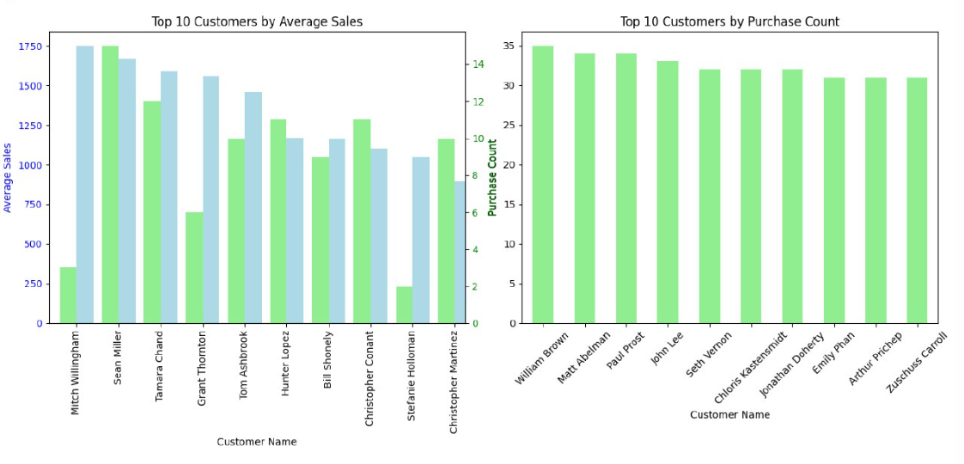

Slide 17
Why some categories have more sales than others
After we did some analysis as follows
Top sales by each category?
Top sales by region
Top sales by sub-category
Top 10 products saled by region
We found out that technology is the most selling category and specifically phones are the most sold sub categories.
And the West is the most region that got sellings, while in east the top 10 products saled are their.

Slide 18
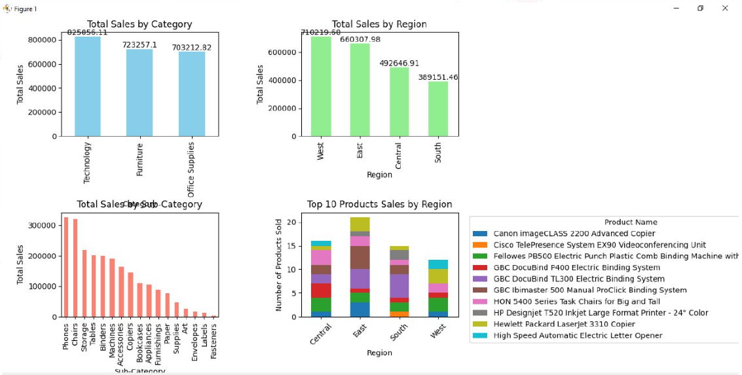
And here are the charts for the previous analysis

Slide 19
Since we agreed that the standard class shipping mood is the most type that delay.
Time to know how much does people use it ,
So we analysed the data to see customer shipping mode prefrence, the average sales by shipping mode and the count of delayed orders by shipping mode.
We found out the standard calss are the most used type due to its low cost compared to other classes.

Slide 20
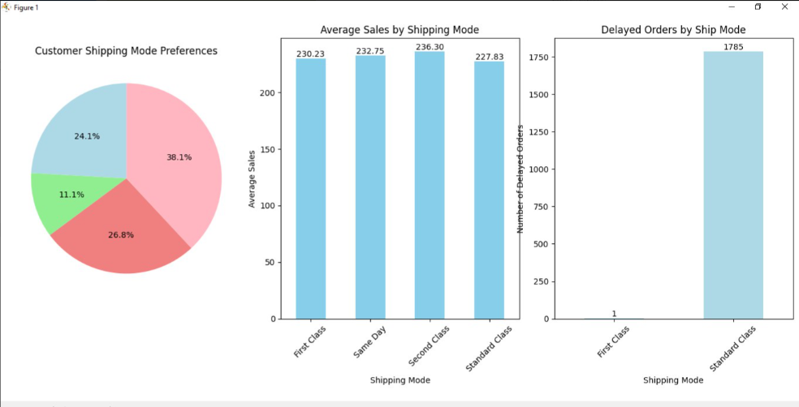

Slide 21
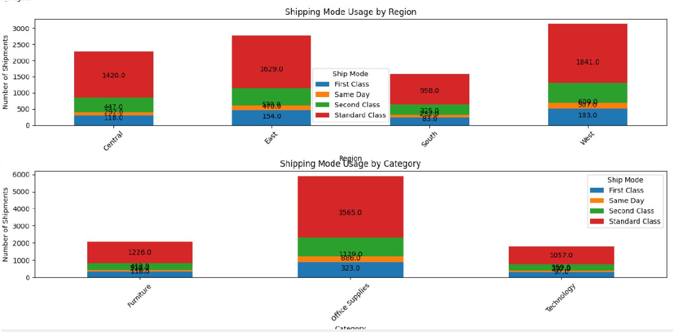
Then we made charts to see the shipping mode usage for each region and category.

Slide 22
we will see in the coming chart the category and sub category trend of
sales.
which might allow us to know the lowest category of selling
and the lowest sub category of selling
and indeed the top for both category and sub category,
And for that charts we made some recommendations
based on the data we had and that will be discussed later

Slide 23
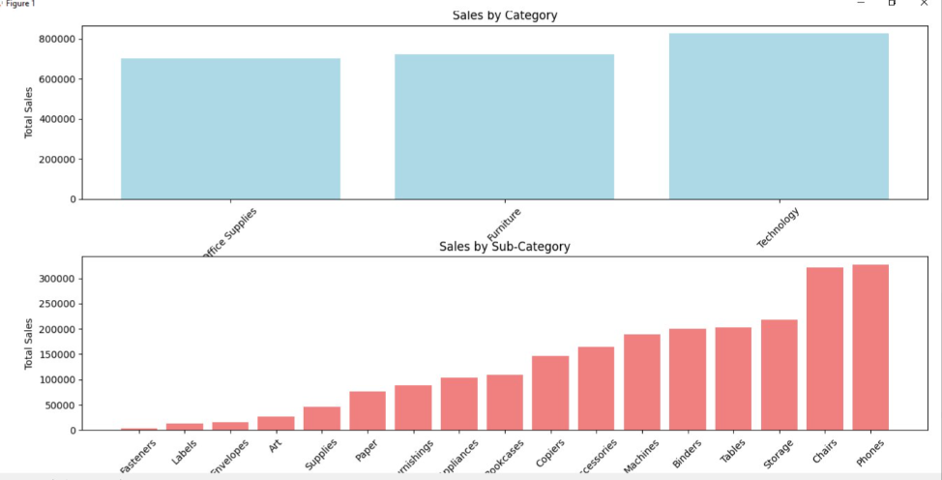

Slide 24

RECOMMENDATIONS
Recommendation 1
Since we spotted the problem that shipping delays comes from people choosing standard class over any other class so we can recommend doing stores in the cities with most selling ratio or any other city that would be easy to make a store in and that store could help mainatin the selling process and the shipping delays since many of people might choose the store collect over the standard shipping mode we might as well do a survey to people to see their satisfaction about the shipping as they might choose the standard mode when the know their might be a delay and the do not have a problem with that.

Slide 25
Recommendation 2
We also noticied from the previous chart that there are some sub categories or products that are low in selling
So, first of all we gotta ask why are this products low in sellings to answer this we can directly ask the customers to know if they are even interested in buying that kind of stuff from that store or they think they prefer it more to buy it on site if people did not have the problem of buying such stuff from the online store then we recommend doing much more marketing on these sub categories, or if is not then we can just stop the loss of making the least in selling as long as they are not profitable

Slide 26
THANK YOU
BY
Mohamed Nabih
Adnan Omar
Fares Hamada
Arwa Abaza
Fatma Tamer

